Slide 1
Qualities of Elders
1 Timothy 3:3

Slide 2
Not Contentious
AMACHOS: A = not; MACHOS = fighting
Peaceable – NASB
Not a brawler – KJV
Not contentious – ASV
Thayer: not to be withstood
All Christians are encouraged not to be contentious – Titus 3:2
Christians are to be peaceable, gentle – 2 Tim 2:24

Slide 3
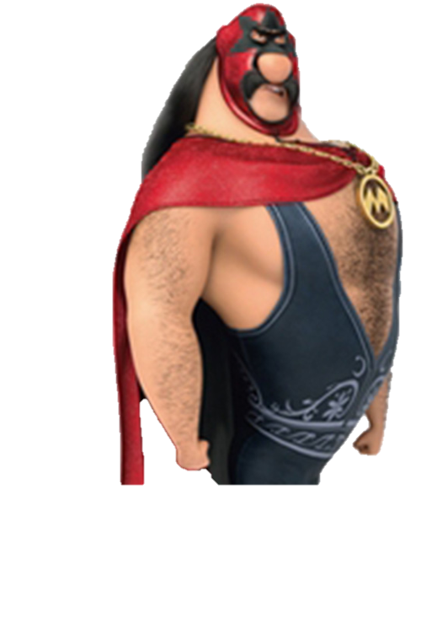
Not Contentious
Why would it be important for an elder to not be contentious, as it relates to dealing with deacons?
What is it like serving under a contentious elder?

Slide 4
One who rules his own house well
Paul moves now from using adjectives to participles. This focuses on the elder’s household life as a quality of this position.
Literally: His own house…
Ruling well
Having his children in submission with all reverence

Slide 5
One who rules his own house well
Rules his house: PROSTIEMI
Presiding over; managing; maintaining
Describes elders – 1 Thess 5:12
Government officials – Rom 12:8
Or just “maintaining” – Titus 3:8, 14
The man who becomes an elder should display the ability to maintain / preside over his house well.
Does this mean an elder has to have his own “house” and can’t rent? – cf Ac 16:15, 31

Slide 6
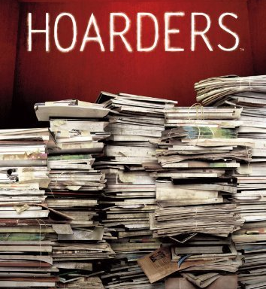
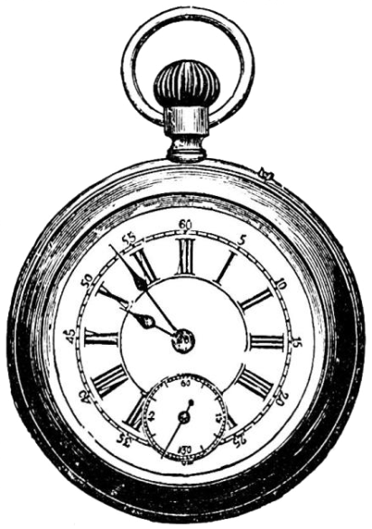
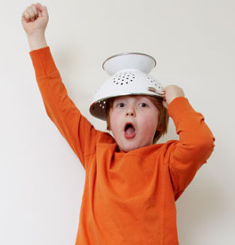
One who rules his own house well
Application:
Why is it important that an elder be able to preside over, manage, or maintain his house?
What is an example of poor household management?
Foolish spending?
Poor time management?
Late bill payment?
Hoarder?
Wild children?
Is this a subjective quality? If so, why?

Slide 7
Having children in submission
Children: TEKNA
Can mean “more than one”
This is known as “plural of class”, where the plural contains the singular. See Luke 20:28, 29; 1 Tim 5:4, 10; Titus 2:4; Genesis 21:7
Does an man have to have more than one child to become an elder?
What about adopted children? – Gal 4:5, 28

Slide 8
Having children in submission
Submission: HOPOTAGE
Obedience; subjection; to arrange; to subordinate
Just as Christians were to be in obedience to the Gospel – 2 Cor 9:13
Paul was not in submission to false teaching – Gal 2:5
Yet, an elder is to have his children in submission.
How does an elder accomplish this?
Does this justify forcing your kids into submission with any means?

Slide 9
Having children in submission
With all reverence: SEMNOTES
“With all gravity” – KJV
“With all dignity” – NASB
This seems to indicate how the children treat their father
Not only that the children are obeying
But expanding how the man works with his kids, and how they react to him overall. IE – not in rebellion
Why is this quality important? See vs 5

